Slide 1
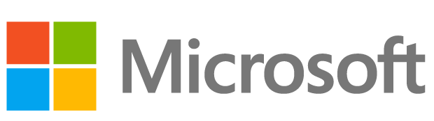
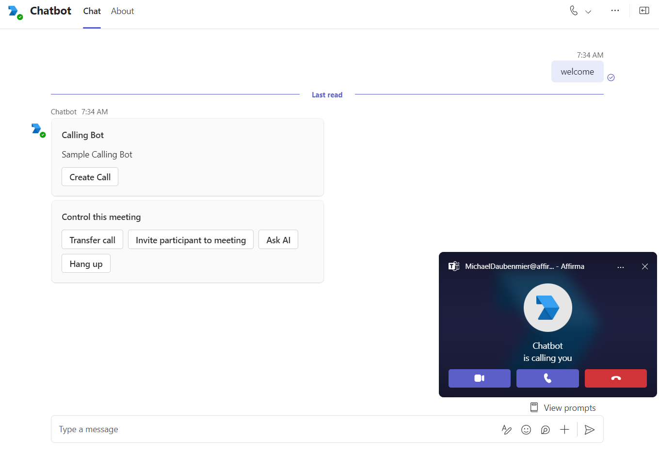
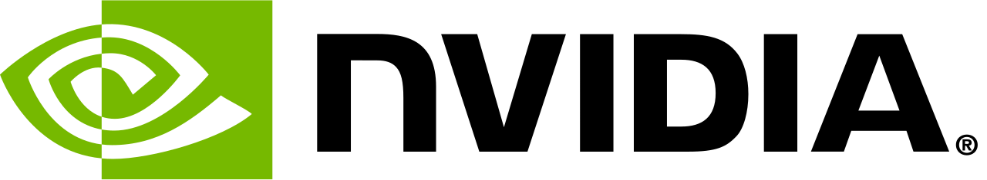
Microsoft & NVIDIA– Agentic AI Demo
Business Need
Microsoft and NVIDIA built a working demo showing how generative AI integrates with Microsoft collaboration tools, giving sellers, partners, and internal teams a practical, repeatable example of conversational AI and voice capabilities in an enterprise setting.
What we Did
Built a working demo based on the Unlocking Innovation with NVIDIA and Microsoft reference architecture
Implemented a Microsoft Teams chatbot using Azure Bot Service and the Teams SDK
Integrated NVIDIA-hosted large language models for conversational responses
Enabled voice input and output using Azure Cognitive Services
Documented architecture and setup to support reuse by other teams
Results
Delivered a production-quality proof of concept that demonstrates real-world AI integration patterns
Provided Microsoft teams with a reusable reference application for AI-enabled collaboration scenarios
Accelerated seller and partner understanding of how to deploy conversational AI in Teams
Established a clear architectural blueprint for future AI demos and customer-facing solutions

